Slide 1
College Tech Math 1A
Section 8.2
Proportions

Slide 2
Proportion
Proportion – statement of equality of two ratios
$$\frac{Unit 1}{Unit 2}=\frac{Unit 1}{Unit 2}$$

Slide 3
Cross Product
For any real numbers $a,b,c$ and $d$, where $b$ and $d$ do not equal 0:
$$\frac{a}{b}=\frac{c}{d}⟺ad=bc$$

Slide 4
Solving Proportions
Solve for x: $\frac{x}{9}=\frac{14}{18}$ (Example)
$$18x=9(14)$$
$$18x=126$$
$$18 18$$
$$x=7$$

Slide 5
Solving Proportions
Solve for x: $\frac{15}{2x}=\frac{18}{9.6}$ (Example)
$$15\left(9.6\right)=2x(18)$$
$$144=36x$$
$$36 36$$
$$x=4$$

Slide 6
Solving Proportions
Solve for x: $\frac{4}{5}=\frac{3x−1}{25}$ (Example)
$$4\left(25\right)=5(3x−1)$$
$$100=15x−5$$
$$105=15x$$
Parentheses are
necessary!
$$7=x$$

Slide 7
Solving Proportions
$$\frac{110 cal}{28.4 g}=\frac{x cal}{42.6 g}$$
The most important part of creating a proportion is to align the units of measure in the ratios.

Slide 8
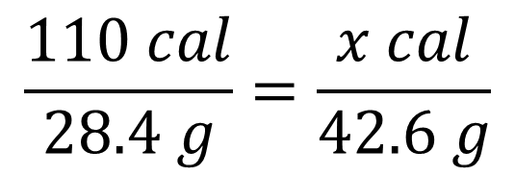
Solving Proportions
$$\frac{110 cal}{28.4 g}=\frac{x cal}{42.6 g}$$
$$110\left(42.6\right)=28.4x$$
$$4686=28.4x$$
$$165 cal=x$$
Include the unit of measure

